Slide 1
Advanced VAPT Report
CONFIDENTIAL — SECURITY ASSESSMENT
OWASP Juice Shop — Local Test Instance
PREPARED BY
METHODOLOGY
REPORT DATE
Tanmay Sarkar
Manual VAPT — Burp Suite
28 October 2026
B.Tech CSE, Tezpur University
Proxy + Repeater, OWASP WSTG-aligned
Testing: 26–27 Oct 2026
Notes:
Title slide. This deck summarizes the Advanced VAPT report on OWASP Juice Shop — a locally hosted, deliberately vulnerable training application. Ten tests were run; two High-severity Broken Access Control issues were confirmed.

Slide 2
What this briefing covers
AGENDA
01
Engagement overview
02
Methodology
Target, tooling and scope for a manual Burp Suite assessment
How each test was performed and validated
03
Findings, F-1 to F-10
04
Risk, remediation & next steps
Two High-severity issues, worst first, with live evidence
Prioritized fixes and what to retest first
Advanced VAPT — OWASP Juice Shop
CONFIDENTIAL

Slide 3
Target & testing environment
ENGAGEMENT OVERVIEW
TARGET
TOOLING
TEST ACCOUNTS
TESTING WINDOW
OWASP Juice Shop
Burp Suite CE
2 accounts
26–27 Oct 2026
127.0.0.1:3000
v2026.7.2 — Proxy + Repeater
UserId 25 & UserId 26
Two sessions, 00:06–20:13
SCOPE — SURFACES EXERCISED WITH REPEATER
Product search & detail
Shopping basket
Basket items (business logic)
Admin configuration
Address book (create, list, IDOR)
Auth headers & session tokens
Advanced VAPT — OWASP Juice Shop
CONFIDENTIAL

Slide 4
Six steps, every test
METHODOLOGY
1
2
3
Proxy configuration
Application mapping
Repeater tampering
Route browser traffic through Burp to observe every request/response
Exercise core features to populate HTTP history and find endpoints, IDs, tokens
Modify and replay search terms, object IDs and headers without repeating the UI action
4
5
6
Response comparison
Authorization validation
Evidence capture
Compare status, body and error content against the original/expected behavior
Replay with/without the Authorization header and across two accounts' tokens
Screenshot the original request, modified request and full response for every test
A finding is recorded only when the response demonstrates unauthorized action or disclosure. A correctly rejected request (e.g. 401) is logged as a working control, not a vulnerability.
Advanced VAPT — OWASP Juice Shop
CONFIDENTIAL

Slide 5
10 tests, 2 High-severity confirmed
FINDINGS AT A GLANCE
2
3
1
3
1
High
Medium
Low
Informational
Inconclusive
F-1
Admin configuration exposed to a standard user token
High
F-8
Confirmed IDOR — cross-account PII disclosure on address endpoint
High
F-2/10
Verbose server errors leak full Node.js/Sequelize stack traces
Medium
F-3
Empty search returns full catalog; unescaped HTML (XSS lead)
Medium
Advanced VAPT — OWASP Juice Shop
CONFIDENTIAL

Slide 6
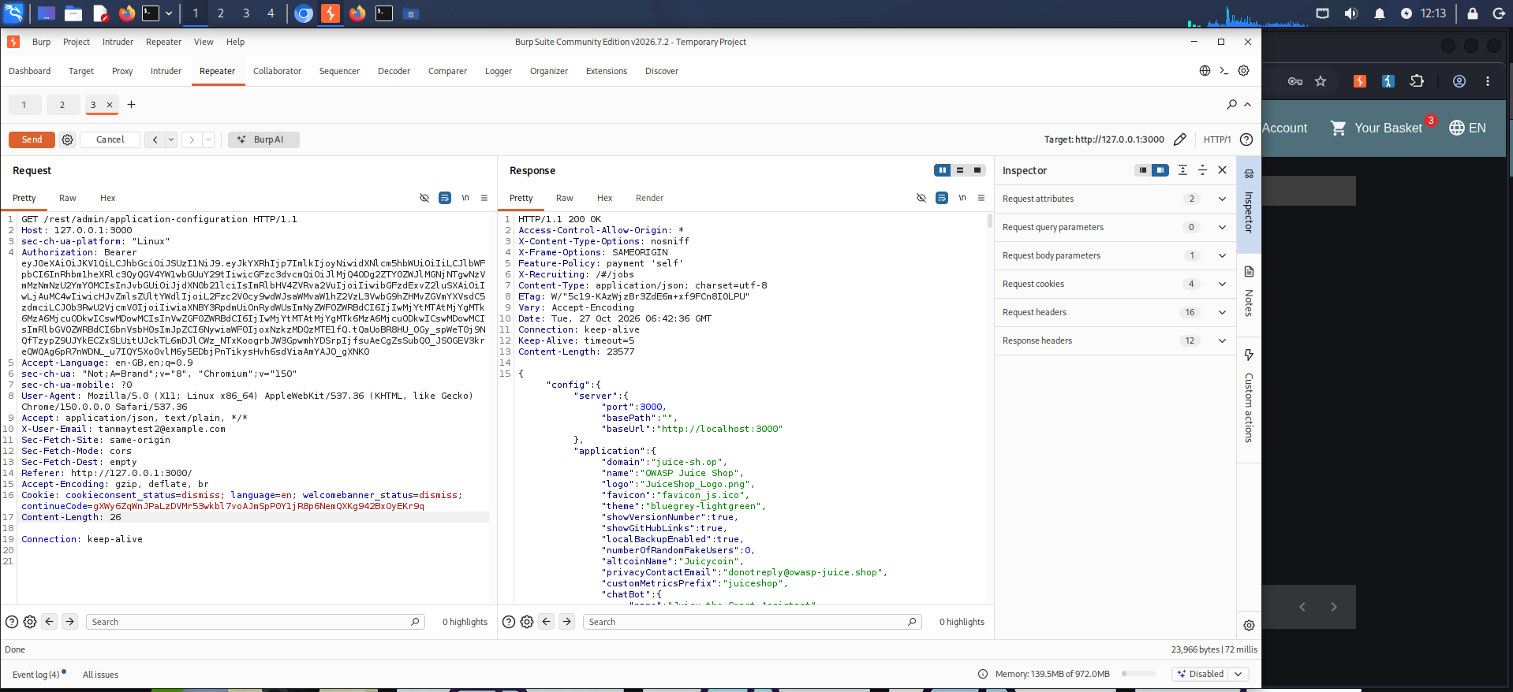
Admin configuration accessible with a standard user token
F-1 · HIGH
REQUEST
GET /rest/admin/application-configuration — sent with only a standard authenticated user token (no elevated role)
RESPONSE
200 OK, 23,577 bytes — full app config, feature flags, privacy contact email, chatbot config
Impact: the server trusts any valid token rather than checking the caller's privilege level for an admin-scoped resource.
Burp Repeater — admin config leaked to a non-admin session
Advanced VAPT — OWASP Juice Shop
CONFIDENTIAL

Slide 7
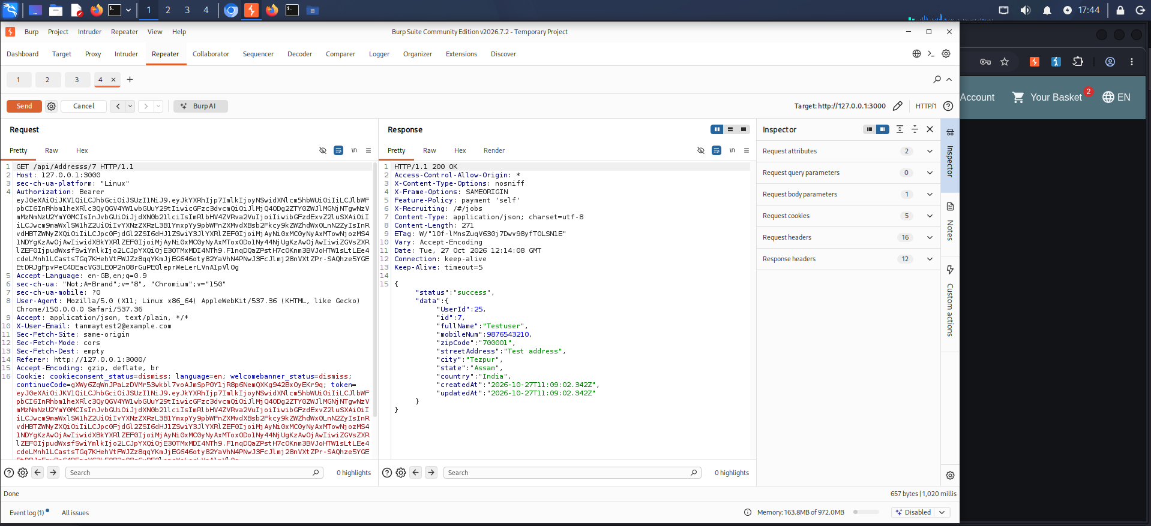
IDOR on the address endpoint — the headline finding
F-8 · HIGH · CONFIRMED
Step 1
GET /api/Addresss/8 with UserId 26's session → returns UserId 26's own record (expected)
Step 2 — same token, ID changed
GET /api/Addresss/7, same session, no header change → returns a full record for UserId 25: name, phone, street address, city, state, zip
Root cause: the server never checks that address.UserId matches the token's UserId — any session can enumerate IDs and harvest other customers' PII.
Burp Repeater — cross-account address record returned
Advanced VAPT — OWASP Juice Shop
CONFIDENTIAL

Slide 8
Protection exists — on the wrong route
F-9 · INFORMATIONAL
/api/Address/{id}
/api/Addresss/{id}
Correctly spelled, singular route
Misspelled route — the one the app actually uses
Request rejected:
Request succeeds:
400 — "Malicious activity detected."
200 OK — full cross-account record (F-8)
An anomaly-detection check is present here …
… but not here, where it actually matters
Takeaway: protective controls that aren't applied to every alias of a resource give a false sense of coverage. Audit the routing table for duplicate handlers.
Advanced VAPT — OWASP Juice Shop
CONFIDENTIAL

Slide 9
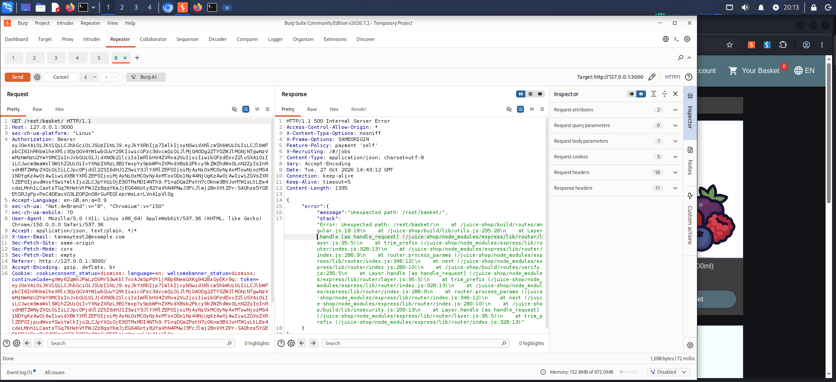
Verbose errors leak the backend, twice
F-2 & F-10 · MEDIUM
TRIGGER 1 — F-2
Duplicate basket item → 500 with a full SequelizeUniqueConstraintError, file paths and query internals
TRIGGER 2 — F-10
GET /rest/basket/ (no ID) → 500 with a full Express/Node.js stack trace, /juice-shop/ file paths exposed
Why it matters: two independent, unrelated triggers hit the same gap — this is a systemic error-handling issue, not a one-off, and it fingerprints the stack for further attacks.
Burp Repeater — 500 error exposing internal file paths
Advanced VAPT — OWASP Juice Shop
CONFIDENTIAL

Slide 10
Empty search returns the entire catalog
F-3 · MEDIUM
UNBOUNDED RESPONSE
STORED XSS LEAD
GET /rest/products/search?q=
"Can be <a href=\"/#recycle\">sent back</a>…"
200 OK, 16,563 bytes — the complete, unfiltered product catalog returned in one response, no pagination or bound.
Product descriptions carry raw, unescaped HTML in the JSON response — a risk if rendered without output encoding (client-side rendering not yet verified).
Recommendation: reject or bound empty queries; sanitize or encode stored HTML before it reaches the API response.
Advanced VAPT — OWASP Juice Shop
CONFIDENTIAL

Slide 11
Not everything failed
WORKING CONTROLS & OPEN ITEMS
F-4
Auth header enforced on basket
F-5
SQLi probe handled safely
Stripping the Authorization header on /rest/basket/{id} correctly returns 401 Unauthorized.
A single-quote probe (') on the search parameter returned an empty result — no DB error or anomalous behavior.
F-6
Basket IDOR — still open
F-7
Minor reconnaissance aids
Inconclusive at the time, but F-8's confirmed address IDOR used the right technique — basket should be retested with a fixed token across enumerated IDs.
Undocumented query params accepted silently; a misspelled route returns 200/[] instead of 404 — low risk, aids enumeration.
Advanced VAPT — OWASP Juice Shop
CONFIDENTIAL

Slide 12
All ten findings, ranked
RISK & IMPACT SUMMARY
ID | Finding | Impact area | Severity
F-1 | Admin configuration exposed to standard user token | Confidentiality, Authorization | High
F-8 | Confirmed IDOR on address endpoint — PII disclosure | Confidentiality, Authorization, PII | High
F-2 | Verbose error discloses Sequelize stack trace | Confidentiality (recon) | Medium
F-10 | Second stack-trace disclosure (malformed basket path) | Confidentiality (recon) | Medium
F-3 | Empty search returns full catalog; unescaped HTML | Confidentiality, potential XSS | Medium
F-6 | Basket object-level access (IDOR) | Confidentiality, Authorization | Inconclusive
F-7 | Unvalidated param; non-404 on misspelled route | Reconnaissance aid | Low
F-9 | Inconsistent anomaly-detection route coverage | Authorization (false coverage) | Informational
F-4 | Authorization header enforced on basket | — positive control | Informational
F-5 | SQLi probe (') handled safely | — positive control | Informational
No Critical-severity finding was confirmed. F-1 and F-8 are rated High: both expose sensitive data to a non-privileged or cross-account session.
Advanced VAPT — OWASP Juice Shop
CONFIDENTIAL

Slide 13
Fix in this order
REMEDIATION ROADMAP
1
F-8 — Add ownership checks to the address endpoint, retest F-6
Verify record.UserId matches the authenticated session on every object-by-ID request; immediately replay F-6 with the same fixed-token technique.
2
F-1 — Enforce role checks on admin-scoped routes
Add isAdmin checks on every /admin/* route; return generic 403 for non-privileged callers; audit sibling routes.
3
F-2 / F-10 — Centralize error handling
Catch ORM and routing exceptions explicitly; disable stack traces for untrusted clients; log full detail server-side only.
4
F-3, F-9 & defense-in-depth
Bound empty search results, sanitize stored HTML, consolidate duplicate route handlers, and add automated authorization regression tests.
Advanced VAPT — OWASP Juice Shop
CONFIDENTIAL

Slide 14
Two High-severity Broken Access Control issues, one shared fix pattern
CONCLUSION
F-1 and F-8 both stem from the server trusting a token's presence instead of verifying who it belongs to. Fixing object- and role-level authorization closes the highest-risk path; the same gap likely extends to the still-open basket IDOR (F-6).
Priority 1
Priority 2
Priority 3
Retest F-6 using F-8's fixed-token technique
Add object-ownership & role checks across /admin and /{resource}/{id}
Centralize error handling to stop stack-trace leaks
Notes:
Closing slide. Thank the audience and offer to walk through any finding in more depth, especially F-8 (the confirmed IDOR) which should drive the retest of F-6.

